Slide 1
Security Automation and Orchestration
The Foundation of Application Migration and Modernization for Regulated Industry
Eric Baran - Segment Lead – DevOps – World Wide Public Sector
Jamie Jones – Sr. Solutions Architect – GitHub
August 21, 2018

Slide 2
SESSION OVERVIEW
Security Automation and Orchestration
What is Secure DevOps?
What happens to our regulated customers today, in adopting DevSecOps models?
Introduction to Security Automation and Orchestration.
Stages of Security Automation and Orchestration Adoption
Cloud Migrator
Cloud Forward
Cloud Native
Collaborative Social Engineering
Review of GitHub as the collaborative hub for effective service transformation on AWS.
Review of GitHub at the core of Security Automation and Orchestration.
Notes:
2 Things to take away from this module:
Secure DevOps, SecDevOps, DevSecOps – Pick your term, they are at the heart of cloud service transformation.
We say all 3, because its critical each group is represented in standups, sprints, iteration, or overall planning. If we’re to “Shift-Left”, we must understand what the security and operational requirements are too, not just what new feature we want to build.
Cloud Services, represent a mechanism to deploy levels of automation of everything from Infra-structure, to policy, to governance, to compliance “As Code”. Cloud promises agility, experimentation and transformative practices. Why would you use the same legacy practices in place on-premise? Trust the automation. Refine your process.
Social Engineering, and the Community of Developers, Partners, and resources, allow organizations to make these types of migrations, while modernizing the process/policy by which they deliver, enhance and innovate. The community is doing this. The resources are out there to get started quickly with AWS, and it is not that hard.

Slide 3
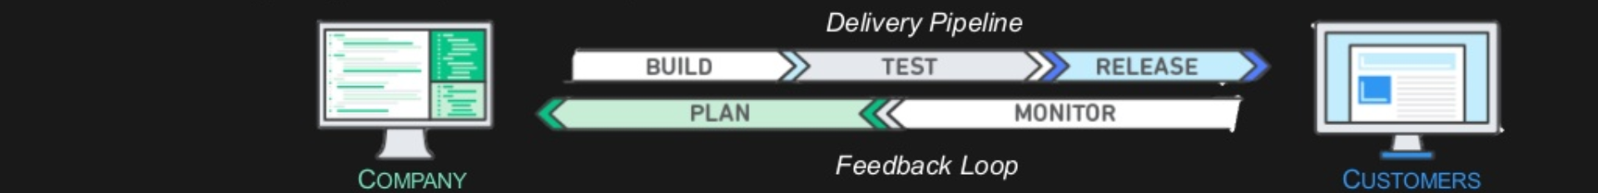
WHAT IS DEVSECOPS?
Union of software development and operations
Migration of Agile continuous development into continuous integration, continuous delivery, and continuous compliance.
DevSecOps Model
No Silos – Puts emphasis on communication, collaboration and cohesion between disciplines
Best practices for change, configuration, and deployment automation
Deliver apps/services at a faster pace
High speed product updates
Everything is code
Notes:
DevOps and DevSecOps – Unification of people, process, tooling to deliver value.
At the core of everything we do, in any engineering effort.
2 Fundamental problems solved:
Consistency of environment problem:
Engineering builds something, pushes to Operations, Ops Motions, something breaks. – “Hey it broke!” – ”I don’t know it built on my desktop”. Packaging environment, compliance, security, test runs, and controls, along side source as code, executing the build out of each environment across dev/test/staging, ensures apples to apples environments, remediation are minutes now.
Speed/Agility – Agile Development promises from the Mission owners!
Beyond consistency of environment, got good at Agile. Mission owner is sold on it, we can release new features every 3 weeks.
Code drops go over
Operations motions
Get to testing, new drop.
Get to staging, another drop.
Ready to move to delivery, another
Mission owner complains to development – Go talk to ops, they can’t move fast enough.

Slide 4
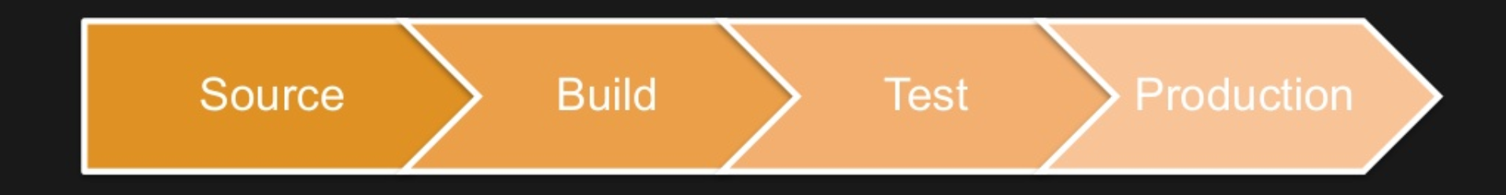
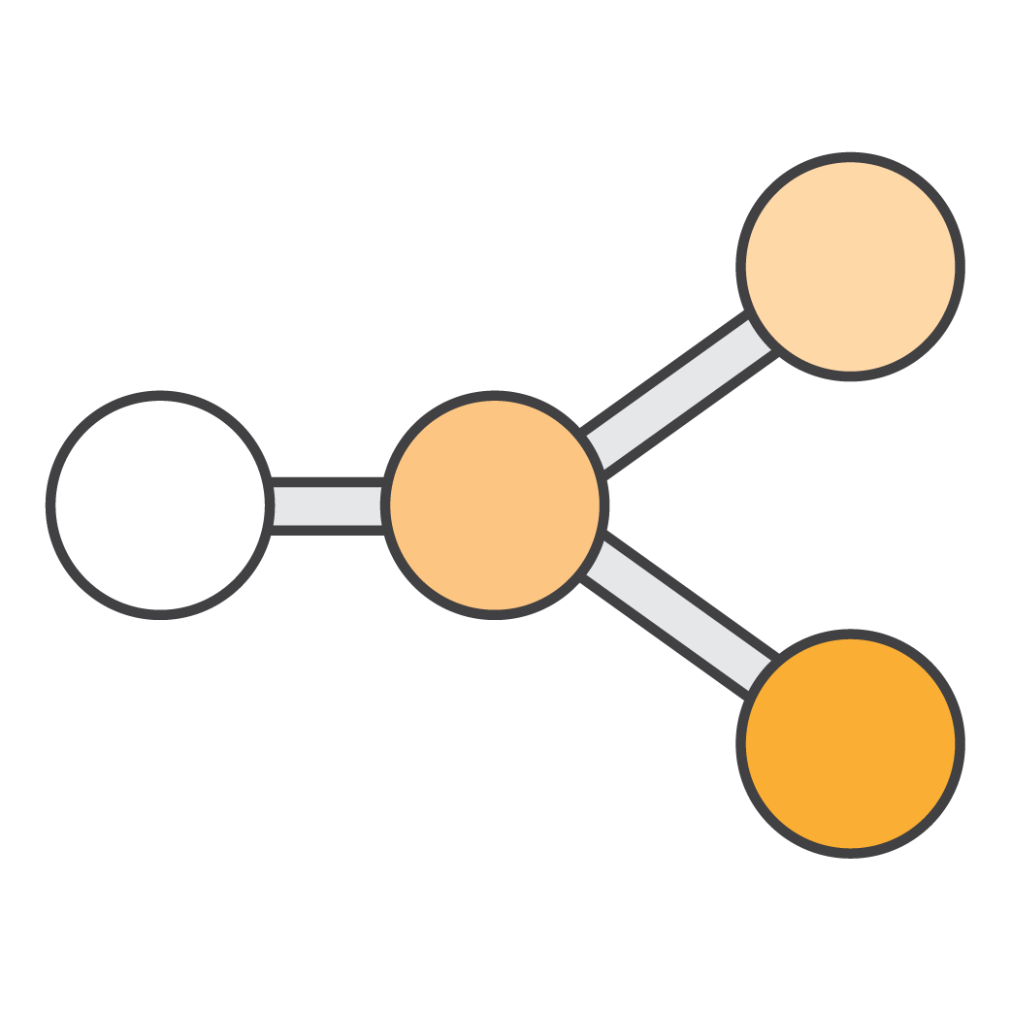



DEVSECOPS PROCESSES: 4 MAJOR PHASES
Check-in source code
Peer review new code
Compile code
Unit tests
Style checkers
Code metrics
Create container images
Integration tests with other systems
Load testing
UI tests
SecOps Scanning
Deployment to production environments
Continuous Monitoring
Notes:
Key points – Modularity across the community – Meeting engineers with the skill sets they have.
Identify 4 phases. – GitHub, with its shared ability to tie into any tool in the SDLC or Release process, can provide out of box ability to deliver meaningful process transformation. Show that later.
The more information we feed into the end-point, the smarter we can be. This includes Access Controls. Compliance Checks. Security Scans. All should be deployed as soon as code is checked back in and built.

Slide 5
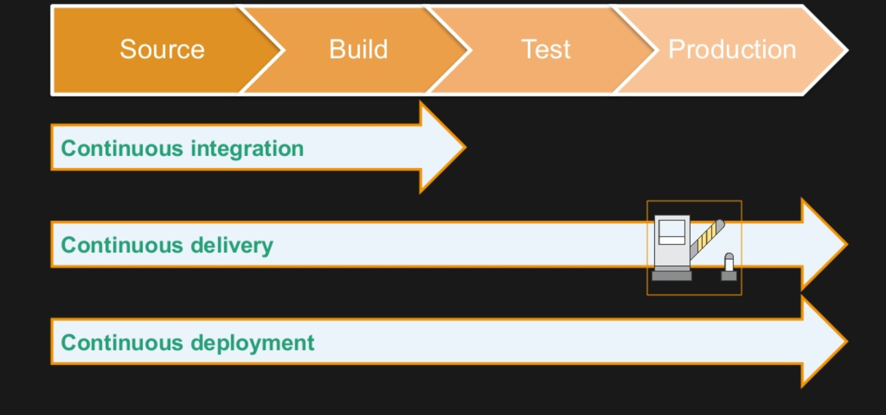
DEVSECOPS RELEASE PROCESSES: LEVELS
Notes:
CI – Adoption phase – Centralized Build/Source mechanism, packaged with environment variables for execution. Testing becomes is done manually.
Cdelivery – Test automation becomes reality – still require sign offs or gates before releasing to production.
Cdeployment – End to end automation of Build, Test, Release, and Compliance checks, consistent push to production.
- Speak to blue green testing, IP swapping, ability to test “In production”.

Slide 6
Problem Statement – Why can’t we be Agile?
Security and risk management leaders continue to labor over “How” do they secure current, legacy and cloud resources consistently within their limited constraints.
While cloud services has provided streamlined ways to achieve innovation through the principles of DevSecOps and Developer Self-Service, regulated customers are still under mandate to follow strict security, governance, and accreditation standards, which are delivered during the production deployment phase.
Notes:
Pure problem on the DevOps side –
Nothing matters if it all comes to a screeching hault in Security. Then it just looks like a different flavor of waterfall – (Push to production every quarter)
Principles of Developer Self Service, in Federal, don’t mean anything if Security isn’t there.
IC Example – May be able to do this in pockets, but at Scale, not having Security/Compliance/Governance as Code along side your Infra-Structure

Slide 7
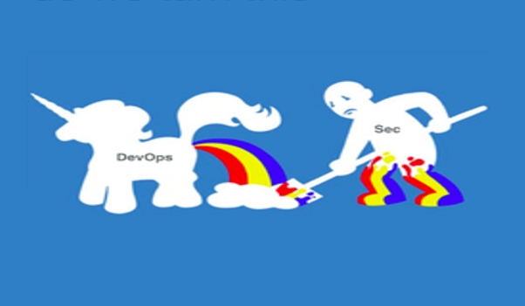
Developer Self-Service – In a Compliance Oriented World
DevOps enables the CI/CD pipeline which is the basis of automation within AWS.
The biggest challenge is breaking out of the traditional security structures and eliminating the divide between developers, operations, and security.
The CI/CD pipeline is the foundation for creating a repeatable, reliable and constantly improving process for taking software from concept to a secure, complaint production solution.
AWSome! But what actually happens in Regulated environments today?
Notes:
Here’s what Happens today:
Developer Self-Service is a core tenant of the DevOps message that we deliver with AWS and GitHub.
Typically Dev and Test workloads, do not share the same compliance/governance rigor as production, so engineering teams reason, why not leverage resources on-demand in a modern way? They start increasing their direct productivity.
The issue, for many customers is that once that workload needs to move to production, an entirely new set of policy requirements need to be implemented, which create blockages in ”agility”. This “Production” deployment, largely is where info-sec will spend months to years, and $100,000’s if not $1,000,000’s, ensuring that the workload is secure, accredited and governed.
For any type accreditation, such as FedRAMP, PCI, IRS1075, etc., our customers will be delivered a code drop ready to be deployed and accredited:
The Security team will then work with operations to build all of the facets the workload needs to run effectively (OS, MW, Database, Integration layers).
The customer will then run a host of process, security scans, governance checks, manual policy enforcement at the physical and virtual layers, (typically leveraging a large list of ISV based solutions, across each distinct check)
The customer now believing the workload is ready to move into the deployment phase, must contact, or work with an auditing firm, to ensure that the workload, and all of its integration points are in-compliance.
The auditing firm then type accredits this “Snap-Shot”, and then process (manual), of working through the formal “Approval of Accreditation”.
Should a change need to be made to the application or workload, the process effectively starts all over again.
For most agencies, and/or highly regulated industries, this will stifle agility and innovation.
This is why most programs, mission owners, and customers, still follow waterfall based methodologies, or struggle to implement Agile Software/DevOps oriented practices. Info-Sec isn’t getting the seat at the table, and in turn, follows their own path.

Slide 8
Solution Overview: SAO
Develop an AWS Security Automation and Orchestration (SAO) repository for constraining, tracking, publishing continuous security configurations, integration, deployments and treatments which are certified against common security frameworks (e.g. FedRAMP, DoD CC SRG, IRS 1075,CIS, PCI, etc.)
SAO will facilitate the orientation and association of DevOps and Security practices, changes and coordination of Continuous Integration (CI), Continuous Delivery (CD) and Continuous Risk Treatment (CRT)* of an AWS customer account and/or multiple accounts.
* CRT is a process and technology approached which is designed to detect, maintain and in MOST case correct security, compliance and threats associated with an organization's solution and service deployment within their AWS account. CRT processes monitor security controls in real-time to ensure the risk and/or threat treatment (Control Intent) is working as designed or at least within an intended margin of acceptance base on guard rails, swim lanes and/or rules built into the control to allow for business operations.
Notes:
What will this look like under SAO?
In partnership with our Security and DevOps segment ISV partners, we will jointly develop a Hardened AMI. This AMI will be packaged with all of the necessary ISV solutions, the customers leverage, in support of their standard accreditation process for production deployments.
This AMI will be hardened, and be deployed as each end-point across the Software Development, Build, and Deployment phases of the application life-cycles.
Security and continuous monitoring solutions will be executing across each phase of the application life—cycle, to ensure constant compliance.
The packages will be codified, and delivered via AWS Marketplace, providing a templated approach to each of the 9 Type accreditation standards.
We are partnering with two, 3 PAO organizations (CoalFire and Kratos), to accredit the package itself.
Not only is the environment type accredited, but everything produced through the MP deliverable has security/governance is built, so that at every level you have continuous compliance running.
GitHub, forms the hub by which these packages are delivered, updated, and managed, to deliver orchestrated “Governance as Code”

Slide 9
Stages of Security Automation and Orchestration
CLOUD NATIVE
Time
Cloud Native
CLOUD FORWARD
Continuous Compliance
CLOUD MIGRATOR
Value
Notes:
Meeting the customer where they are in their journey.
The SAO frame-work allows the earliest AWS Adopters, and the most legacy oriented “On-Prem” teams, to follow a core and standard methodology, ensuring compliance and accreditation base lines.

Slide 10
Regulatory Standards – What will SAO Satisfy? – Phase One
The Payment Card Industry Data Security Standard (PCI DSS)
Defense Federal Acquisition Regulations Supplement (DFARS) NIST SP 800-171
Federal Risk and Authorization Management Program (FedRAMP) (Moderate-Impact)
Federal Risk and Authorization Management Program (FedRAMP) (High-Impact)
Department of Defense (DoD) Cloud Computing Security Requirements Guide (SRG) Impact Level (IL) 2
Department of Defense (DoD) Cloud Computing Security Requirements Guide (SRG) Impact Level (IL) 4
Internal Revenue Service (IRS) Publication 1075 Tax Information Security Guidelines
Minimum Acceptable Risk Standards for Exchanges (MARS-E) 2.0
The Criminal Justice Information Services Division (CJIS)
The Center for Internet Security (CIS)– Critical Security Controls
The General Data Protection Regulation (GDPR) (Regulation (EU) 2016/679)

Slide 11
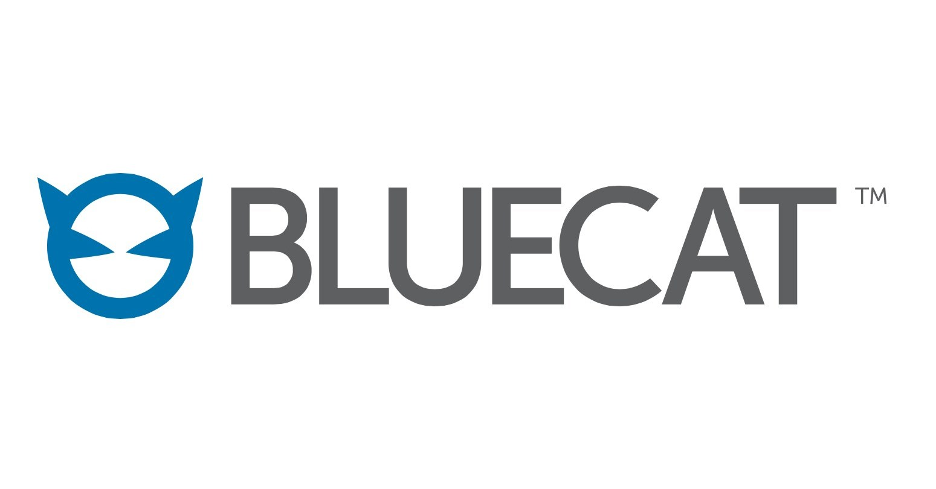
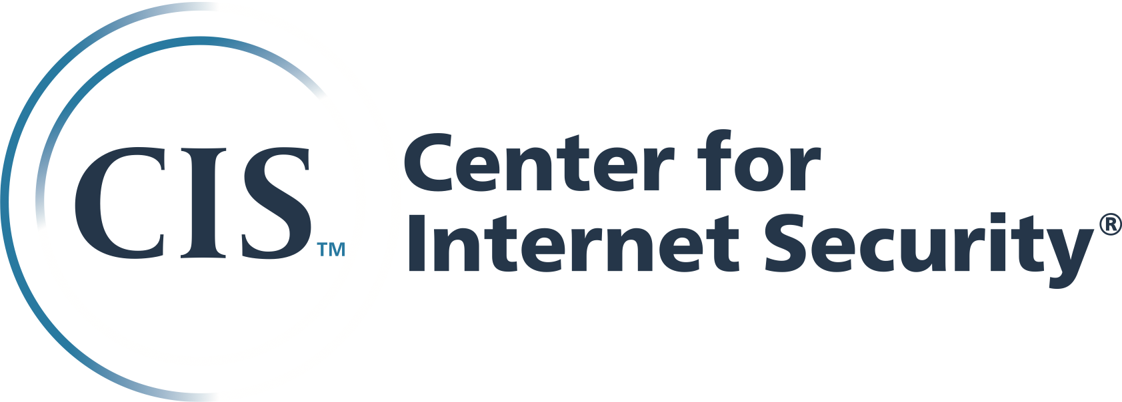


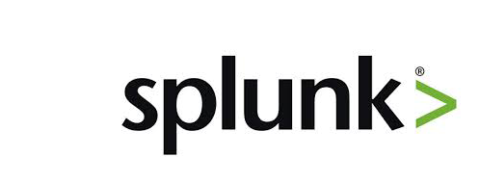
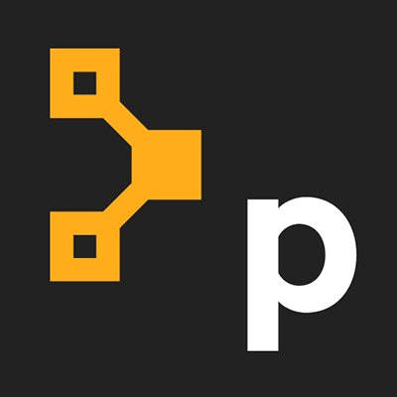
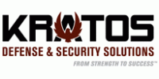
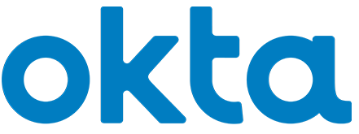

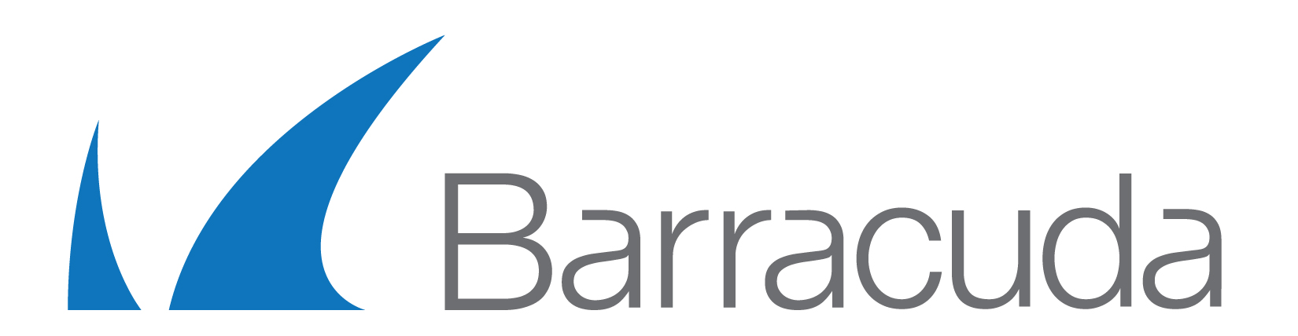

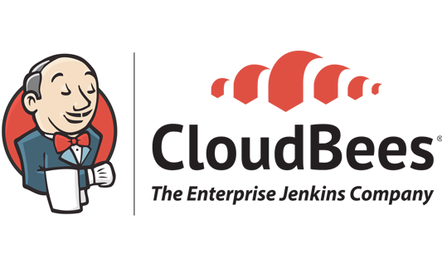

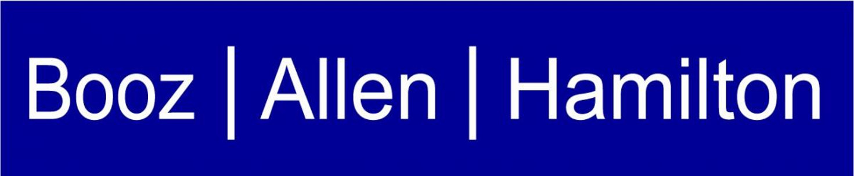

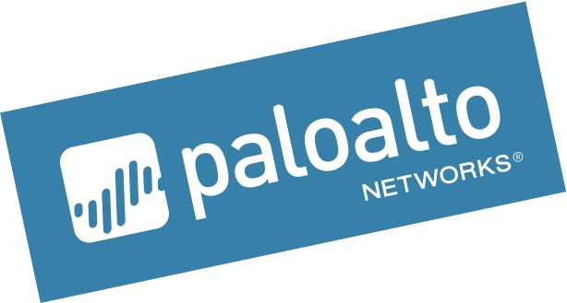
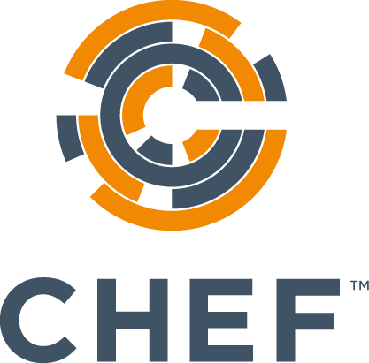
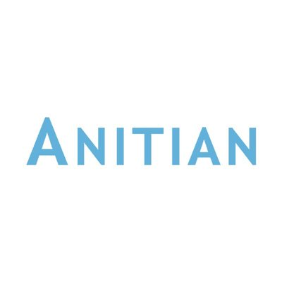
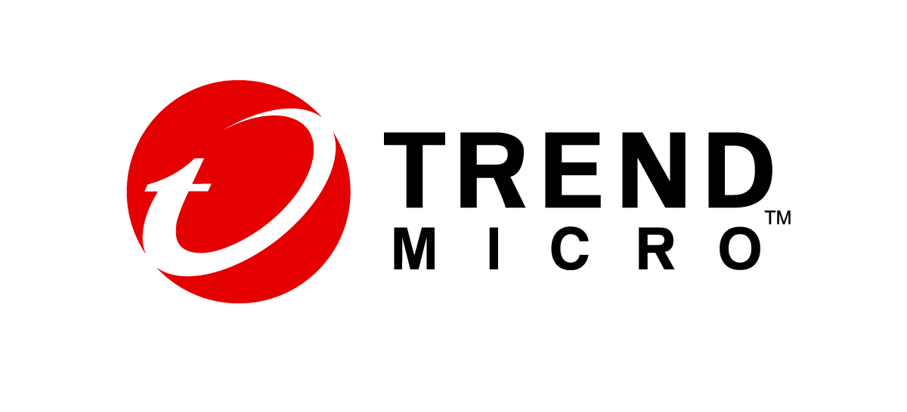
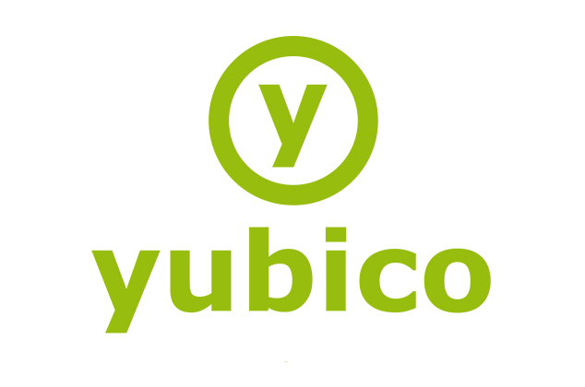
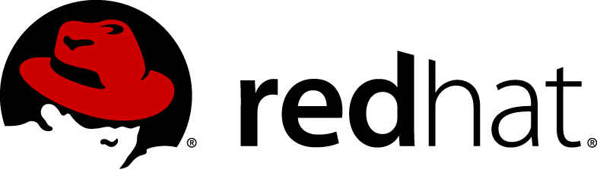
SAO Community (to date) - Who’s involved?
Notes:
Still working with partner team to confirm all logos
And this is a GLOBAL program – we already have partners in LATAM, Europe, and Australia, and we really want to see more of you taking advantage of this – THIS is the new “high bar” to achieve for partners.
At Amazon we talk a lot about raising the bar, and setting a high bar for everything we do. This is our new HIGH BAR for you, our partners in the government space around the world. We are here to help you achieve this competency and know you’ll use this as a platform to further grow your businesses.

Slide 12
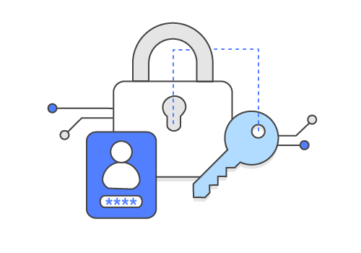
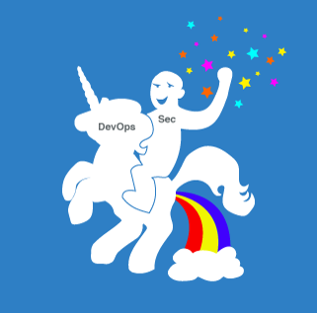
The Result: “AWS Trust Boundary In a Box”
Templates, Scripts, Functions and Recipes for securely deploying regulated workloads
“Type Accreditation” (Pre-Audited), for all stages of Cloud Service adoption, (Migrator, Forward, Native)
Defined operational security and compliance tolerances scripts, functions and treatments (e.g. Guard Rails) for constrained secure operations across the DevOPS CI/CD and CRT through the use of Governance as Code (GoC) practices
Deployable Continuous Risk Treatments (CRT) resources (e.g. AWS & Partners solutions)
Notes:
Our Solution will be fully Modular in nature, meeting the customer where they need to be, leveraging the partner solutions they have developed skill-sets for.
The Top DevOps Partners aligned to this initiative are:
GitHub
Chef
Puppet
Ansible – (Red Hat)
With plans to add Hashi-Corp and other emerging solutions as we enhance the overall value proposition
The Top Security Partners aligned to this initiative are:
CIS
Anitian
Allgress
Telos
Splunk
CloudChecker
Barracuda
Palo Alto Networks
CoalFire
Kratos
Booz Allen Hamilton
Yubico
OKTA

Slide 13
Thank You!

